Slide 1
Workload Staffing Reports (Online)
March 2020

Slide 2
WSR Reminders
From Collective Agreement Article 1103
A joint union/management form
A tool for MNU members to document workload and staffing concerns
Used when quality patient/resident/client care may be jeopardized
Documenting and attempting to resolve care concerns is part of nursing professional responsibility

Slide 3
Workload Staffing Problem-Solving Process
Nurse discusses issue at unit/ward/program level
Nurse discusses issue with the designated out of scope manager
If issue unresolved, nurse(s) complete(s) WSR
The objective is for dialogue and problem-solving at the initial level

Slide 4
Online WSR accessed 2 ways: 1. https://workloadstaffing.manitobanurses.ca/
2. Shortcut on employer computer Desktop
Click on “Shortcuts” (at top of screen)
Will display “Shared Health Shortcuts”
Click on “Nursing Workload Staffing Report”

Slide 5
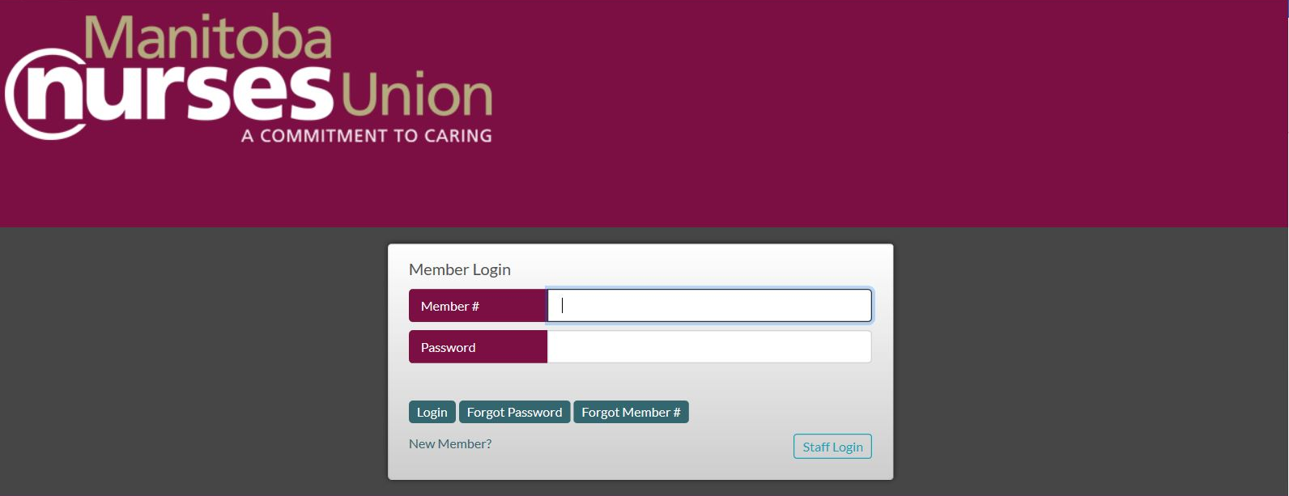
screenshot
You need your MNU Member # and member portal password
You need manager's work email address
There are other required fields in order to submit online
If you are unable to submit online for any reason, please submit paper form instead

Slide 6
Online WSR Landing Page
Review information and tips found in middle of page
Click on appropriate “Create New Report”:
+Acute Care
+Community Care
+Long Term Care
Can also select “Recent Draft Report”, “In Progress Reports” or “Completed Reports”

Slide 7
Reminders
Do not identify patient/client/resident/family or doctors
Avoid abbreviations
As you input information, you can click on “Save Draft” at any time to ensure you retain what you have entered if you get interrupted.
All parties shall use WSRs as a tool in problem-solving and are expected to document respectfully.

Slide 8
General Information Required Fields
Your first name and last name
Work email preferred. Use personal email only if no work email address
If work at more than 1 place, use work email for the facility/workplace involved
Name of manager notified and their work email
Date (and time) manager notified
Health Care Region
Local or worksite
Date of situation

Slide 9
General Information…continued
Employer
Unit, program, area (be specific)
Time of situation (start and end)
Day of week
Select shift type and length from dropdown menu
Total # of beds, total # patients, total # of residents as requested

Slide 10
Staffing/Working Conditions
Indicate if sick call, vacancy or other reason for staff shortage
# of regular staff (baseline)
# of actual staff
For CRN or other nurse categories that are not provided, include them under the appropriate nurse designation
“Other” category is for other staff (e.g. clerk)
Indicate if any agency, casual, grad or float nurses (prn)
Overtime, select “N/A”, “Yes” or “No”
If OT, indicate how many nurses and how long
Breaks, check off if “Missed” or “Late”

Slide 11
Planned vs Actual Workload Section
This section is optional
It’s found on LTC and Community Care reports only
It can be used to quantify the # or length of various activities
How did the actual # or time spent vary from what was planned?
If preferred, indicate “N/A” and explain in the Details section instead

Slide 12
Details of Unresolved Situation
Provide a concise summary of how the unresolved situation affected your nursing practice/workload
Was care compromised/not completed? Required, you must select “Yes” or “No”
If enter “Yes”, required to indicate how care compromised (check box and explain)
Select either “Isolated incident” or “Ongoing problem”

Slide 13
Patient/Resident/Client Care and Other Contributing Factors
Check off factors that contributed to situation
Add #s, where requested
Add additional explanation/information under “Specify here”
For any incidents/occurrences/RL6, include form #

Slide 14
Availability of Alternatives
Provide details of the discussion with out of scope manager
Select “Yes” or “No” and provide details of guidance provided by out of scope manager
If additional staff provided, select category and provide details
Were other measures implemented? Select “N/A”, “Yes” or “No”

Slide 15
Recommendations
The nurse provides problem-solving recommendations
Check off and explain strategies that could be utilized in the future
Use “Other” for separate ideas
Using your knowledge, skills and judgement, your professional opinion is stated

Slide 16
Nurse Signatures
Can be “signed” by one nurse or several nurses
Click “+ Add Signature” if more nurses agree to sign
Any nurses signing, must verbally agree to have their name added
Consent box must be checked for all nurse names, (including author) that agree to sign
Agency nurses or non-MNU members do not sign
Submit only 1 form per situation

Slide 17
Submitting a Report
Click on “Submit Report” tab at top of page
If any required information is missing, the missing information will be outlined in red or have a message in red, indicating what’s needed.
Once submitted, you cannot edit your report
You can select ”Save Draft” if you do not finish
Clicking “Cancel” will close the form
Ensure that you log off

Slide 18
What Happens Once Submitted
Nurse receives auto email notification that WSR submitted
Local/worksite gets auto email with nurse name (author), form # and PDF
Manager cited on WSR gets auto email with nurse name, form #, PDF of report and due date for response

Slide 19
Management Comments
Manager email contains link to a submitted WSR
Click on the link and scroll upwards to view entire form
Manager will see whole form but unable to edit other than “Management Comments” section
Review entire form, especially “Details of Unresolved Situation”, “Availability of Alternatives” and “Recommendations” sections
Manager name will auto-populate “Manager” box, but can be changed if another manager is responding
Type response in “Comments” box

Slide 20
Management Comments
Out of scope manager shall provide a written (typed) response as soon as reasonably possible and no later than 14 days after the form has been submitted.
Response will outline the action(s) taken and any further actions to be implemented
Indicate if not notified at time of situation
Click on “Submit Response” tab at top of form

Slide 21
After Manager Submitted
Manager gets auto email with PDF of completed report
Manager forwards email with PDF to Director/CNO
Manager forwards email with PDF to NAC Management co-chair
Nurse receives auto email notification that manager responded
Local/worksite receives auto email with form # and PDF
Data from completed WSR becomes automatically accessible to MNU provincial office

Slide 22
WSR Response and Status
Nurse (author) logs into system to view manager response
Nurse can view status of own WSRs any time by logging into online system
Nurse can select “In Progress Reports”, “Completed Reports” or “Recent Draft Report”
Online system retains record of individual nurse (author) reports

Slide 23
Nursing Advisory Committee
All WSRs are referred to NAC meetings for discussion
NAC co-chairs provide follow-up to nurse
If issue remains unresolved from the perspective of the nurse(s), it may be referred to an Independent Assessment Committee (IAC) through NAC

Slide 24
For more information visit: manitobanurses.ca/workload-staffing-reports
Questions can be directed to: dwinterton@manitobanurses.ca

